Slide 1
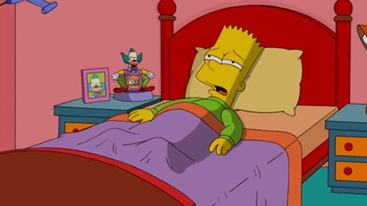
wake up
Bart wakes up

Slide 2
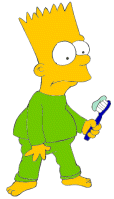
brush his teeth
Bart brushes his teeth

Slide 3
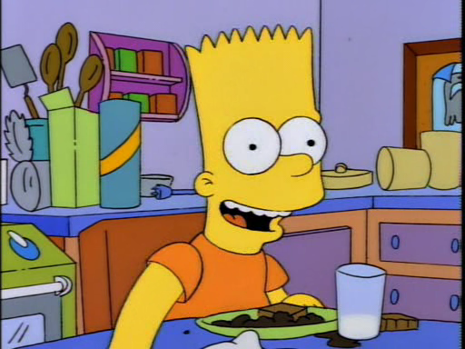
eat breakfast
Bart eats breakfast

Slide 4
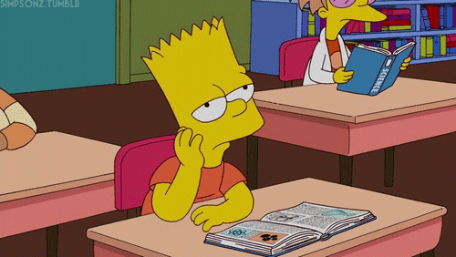
go to school
Bart goes to school

Slide 5
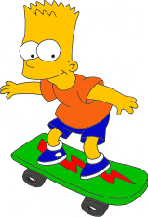
skate
Bart skates

Slide 6
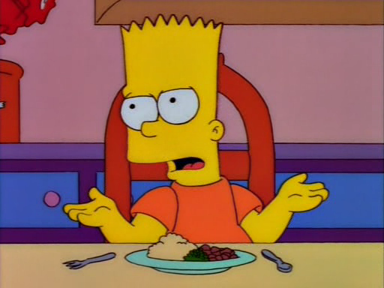
have lunch
Bart has lunch

Slide 7
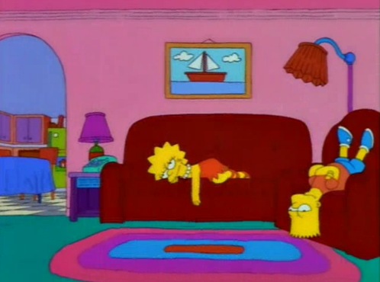
watch TV
Bart watches TV

Slide 8
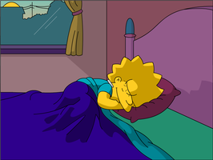
wake up
Lisa wakes up

Slide 9
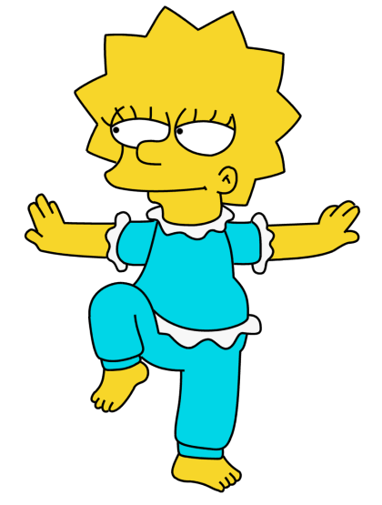
do exercises
Lisa does exercises

Slide 10
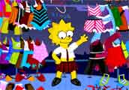
get dressed
Lisa gets dressed

Slide 11
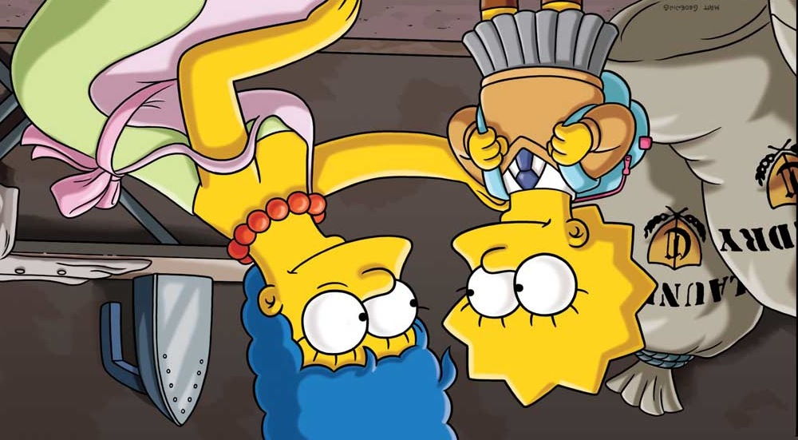
go to school
Lisa goes to school

Slide 12
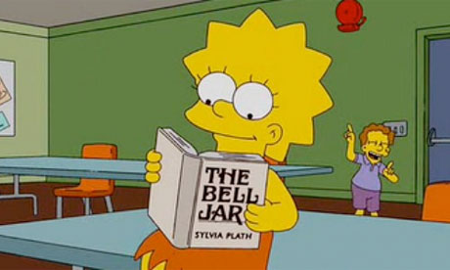
read books
Lisa reads books

Slide 13
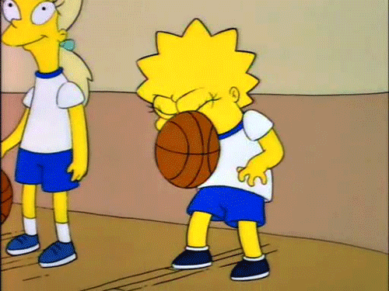
play basketball
Lisa plays basketball

Slide 14
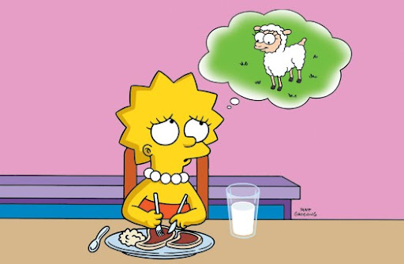
have lunch
Lisa has lunch

Slide 15
do homework
Lisa does homework

Slide 16
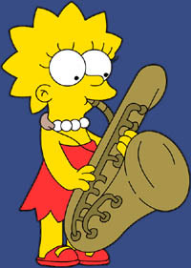
play music
Lisa plays music

Slide 17
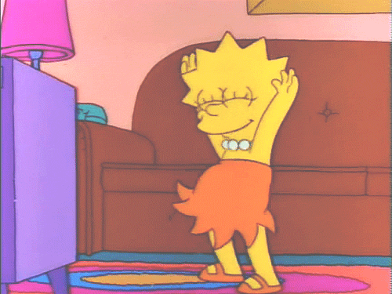
dance
Lisa dances

Slide 18
I | My friend
read | reads
play | plays
sing | sings
eat | eats
run | runs
ski | skis
skate | skates
jump | jumps
wash | washes
brush | brushes
have | has

